Slide 1
VLSI Design
Dr. Charles R. Severance
www.ca4e.com
online.dr-chuck.com

Slide 2
Outline
Transistor density and scale
VLSI – Chip Layout and manufacture
Notes:
BJT = Biploar Junction Transistor
PMOS = P-channel Metal-Oxide-Semiconductor
NMOS = N-channel Metal-Oxide-Semiconductor
CMOS = Complimentary Metal-Oxide-Semiconductor
VLSI = Very Lage Scale Integration

Slide 3
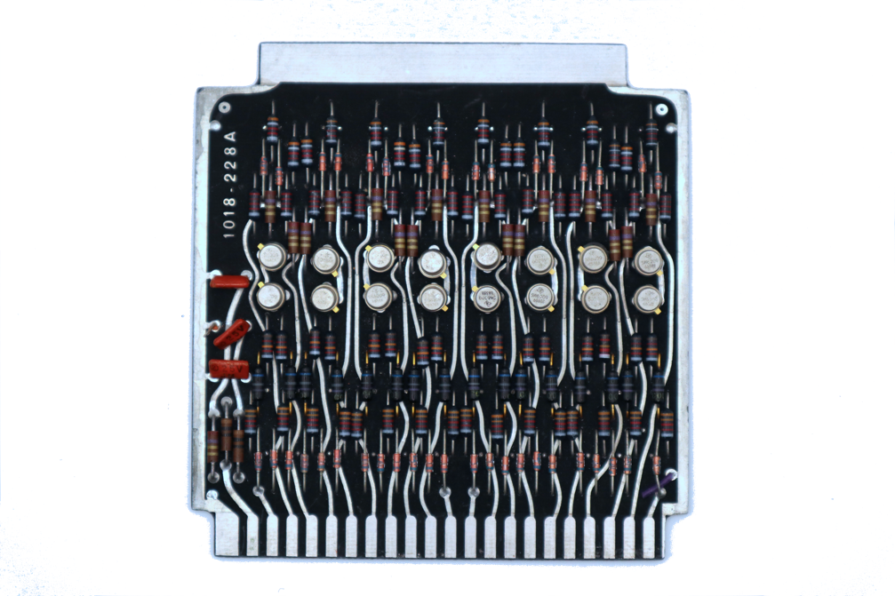
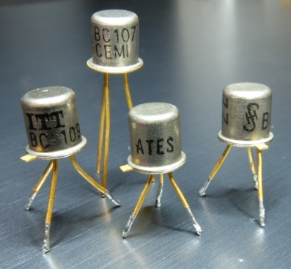
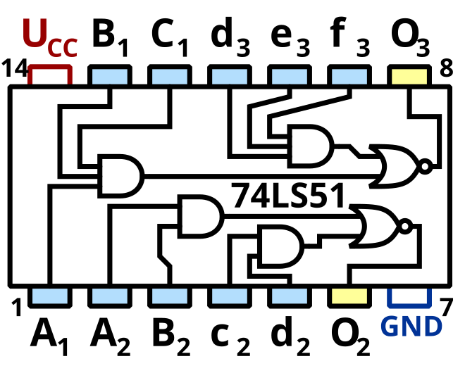
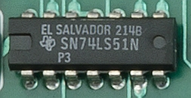
Scale Over Time
Individual transistors connected with other electronics on a "board"
Integrated circuits with a few transistors or gates
https://en.wikipedia.org/wiki/TO-18
https://en.wikipedia.org/wiki/List_of_7400-series_integrated_circuits

Slide 4
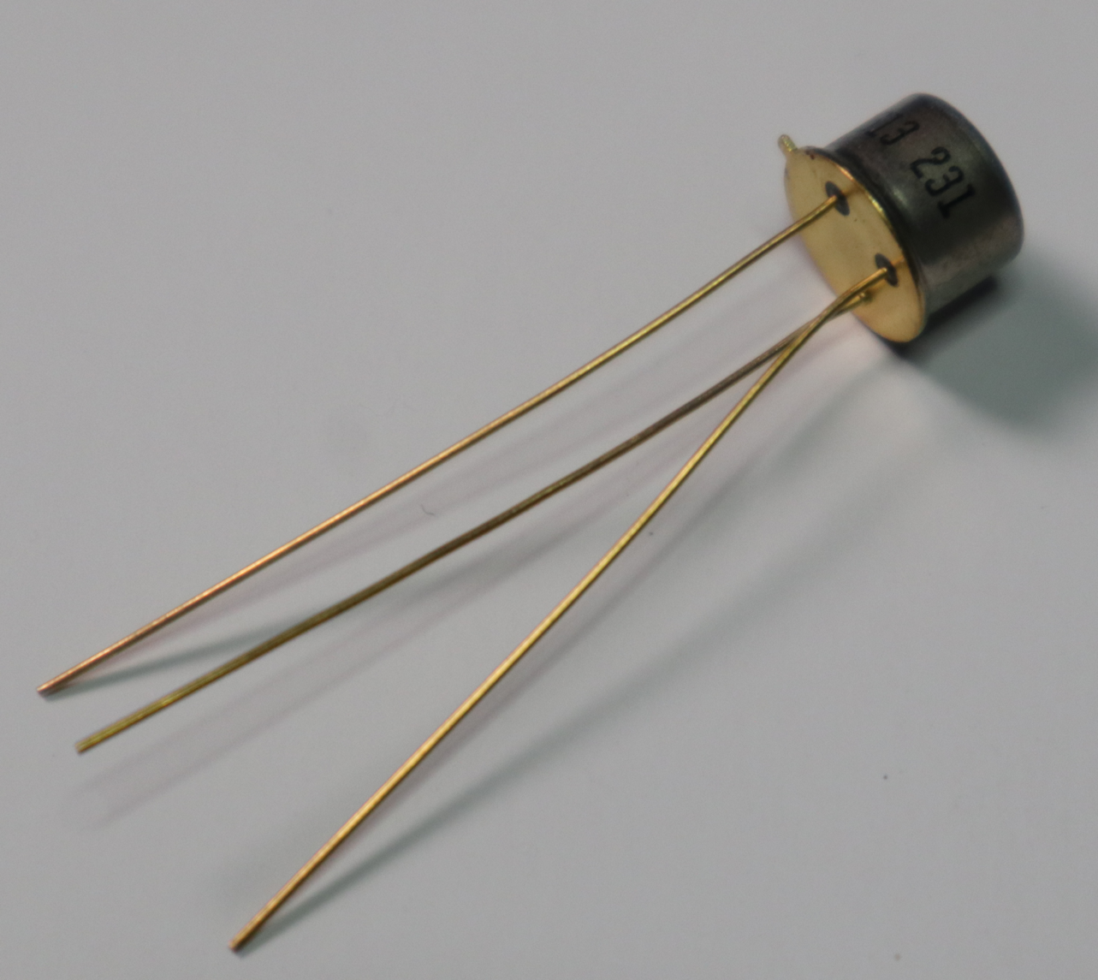
Planar Transistors
Fairchild 2N1613
First planar
transistor
1960
Prior to 1960, transistor assembly required assembling small crystals and connecting wires to them – they were three dimensional "Lego like" constructions
In 1960 Fairchild introduced the 2N1613 transistor – the first that was manufactured by a two-dimensional process.

Slide 5

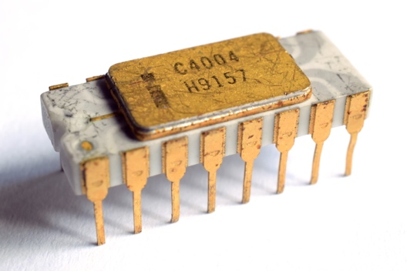
Very Large Scale Integration (VLSI)
2300 PMOS transistors manufactured using photo lithography – 0.01 mm
The Intel 4004(1971), was the first commercially available single-chip, general-purpose microprocessor
3mm
4mm
https://en.wikipedia.org/wiki/Intel_4004
Notes:
An Intel 4004 microprocessors chip - exterior view.
A picture of the internal layout of the Intel 4004 circuitry taken with a microscope showing gates and wires.

Slide 6
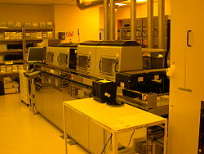
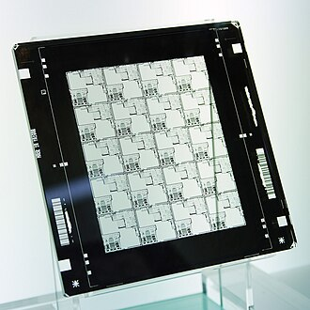
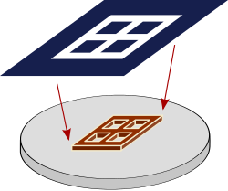
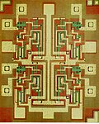
Photo Lithography
Multiple masks with
different chemicals
Four Input NAND
Seven transistors
TI 7420
https://en.wikipedia.org/wiki/Photolithography
https://en.wikipedia.org/wiki/Photomask
https://en.wikipedia.org/wiki/Semiconductor_device_fabrication
Notes:
A photo mask. This photo mask has 20 copies of the same circuit pattern or design. It represents one layer in a chip manufacturing process.
A schematic illustration of a photomask (top) being reduced and projected onto an Integrated Circuit layer (bottom) for printing
NAND gate with 4 inputs in transistor-transistor logic; 7 transistors on the chip as viewed on a microscope.
A close-up of a TI 74LS51 chip installed in a circuit board
A semiconductor device manufacturing facility at HP Labs

Slide 7
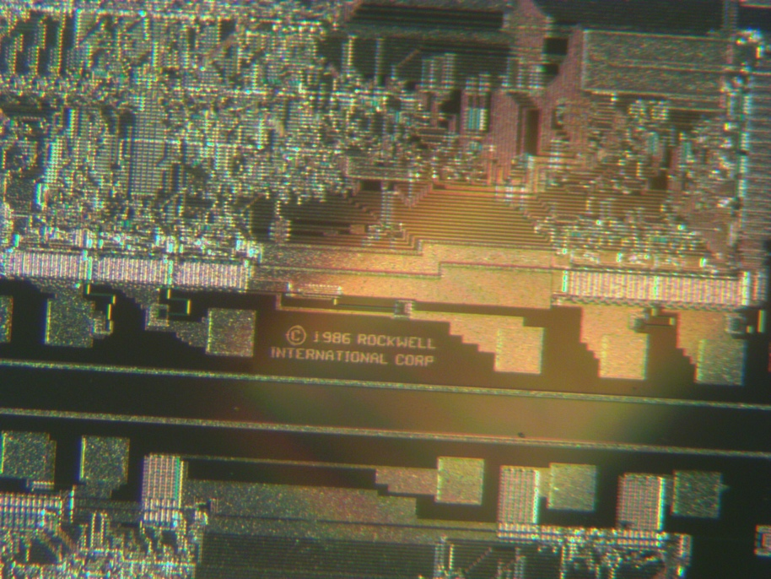
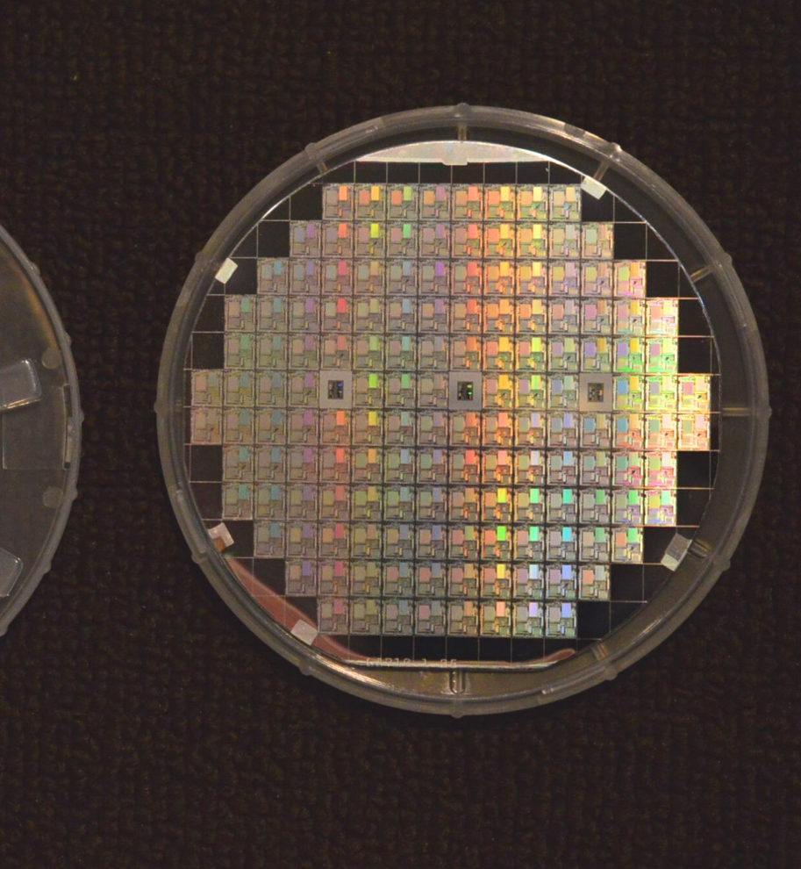
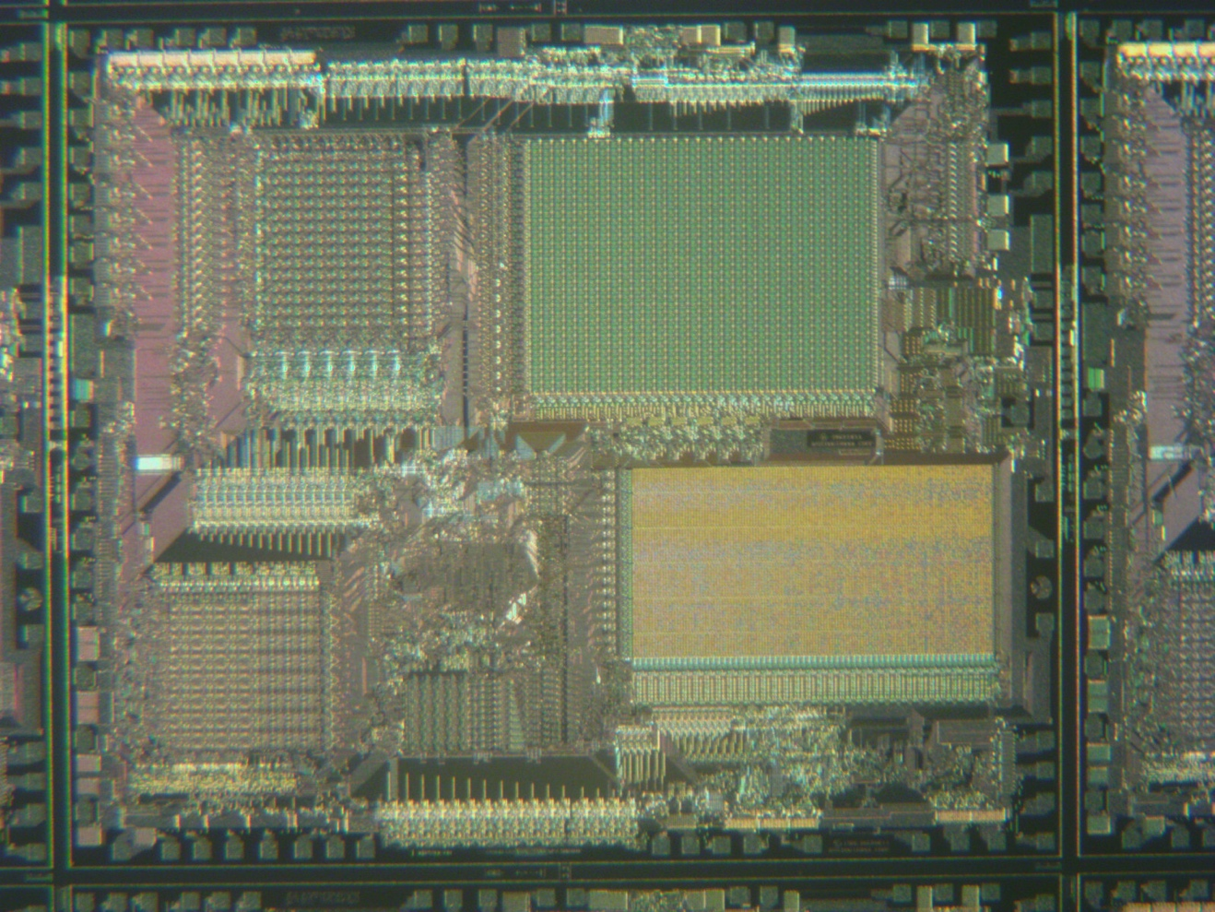

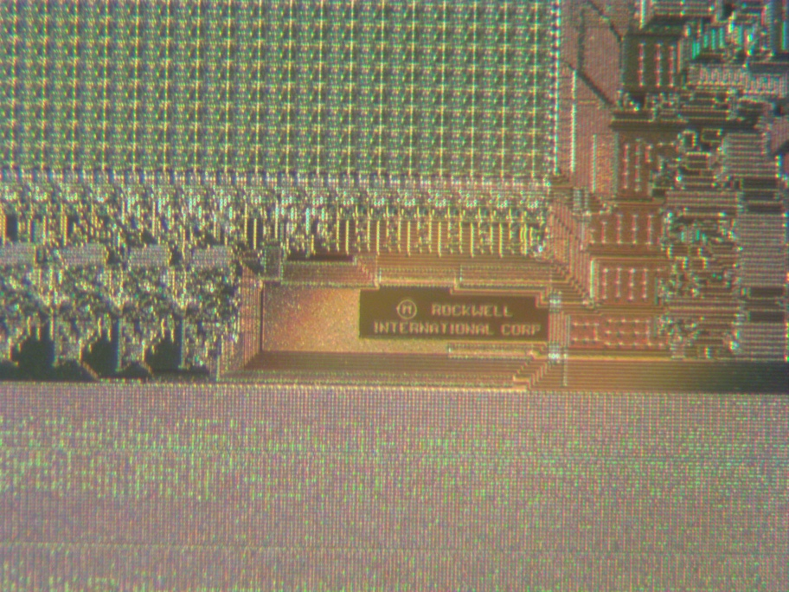
Rockwell silicon wafer (1986)
Fairchild 2N1613
First planar
transistor
1960
Photos courtesy of ebay user kaijusears
Notes:
A Fairchild 2N161e transistor. It is a metal cylinder about 1/4 inch in diameter and 1/4 inch tall. It has three wires coming out of the base. The Fairchild 2N1613 Transistor was produced and commercially available in 1962. It was the first planar transistor ever produced and was a great step forward in mass-producing individual transistors.
Complete Rockwell silicon wafer (1986) it is round and about 4 inches in diameter with very intricate almost microscopic electrical traces and transistors. It has about 120 chips and each chip is about 1/4 inch on a side.
Close up of a single 1/4 inch processor from the Rockwell silicon wafer (1986). It was taken with a microscope at about a 10X magnification and you still cannot see any individual wires because they are so small.
Close up of the edge of s single 1/4 inch processor from the Rockwell silicon wafer (1986). It was taken with a microscope at about a 30X magnification, and you scan finally see contacts and a few wires. It also has a “Copyright 1986 Rockwell International Corp” marking printed on the chip.
Photos courtesy of ebay user kaijusears

Slide 8
Growth of transistor count
The Intel 4004 had 2300 transistors in 1971
The Intel Itanium was the first billion-transistor chip in 2001
Nvidia's Blackwell-based B100 GPU with 208 billion MOSFETs in 2024
Deep learning wafer scale engine by Cerebras has 2.6 trillion MOSFETs 2020
https://en.wikipedia.org/wiki/Transistor_count

Slide 9
Very Large Scale Integration (VLSI) Layout
Building circuits with millions of transistors through photo lithography

Slide 10
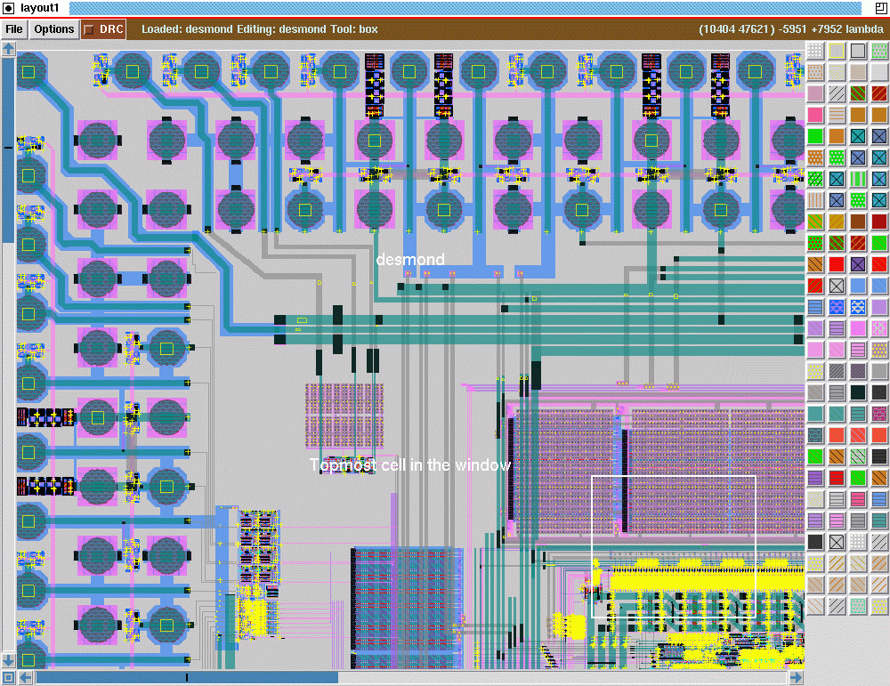
Magic Open Source VLSI Design Tool
Created at Berkeley in 1983
Open source
Popular in academia
Many tutorials
http://opencircuitdesign.com/magic/

Slide 11
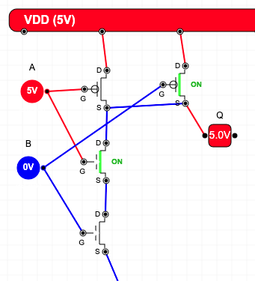
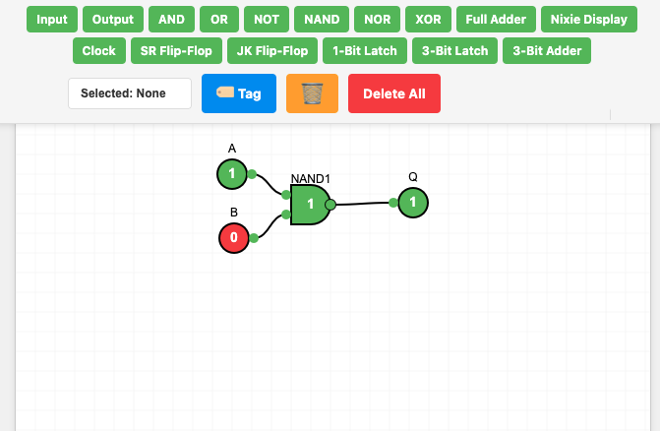
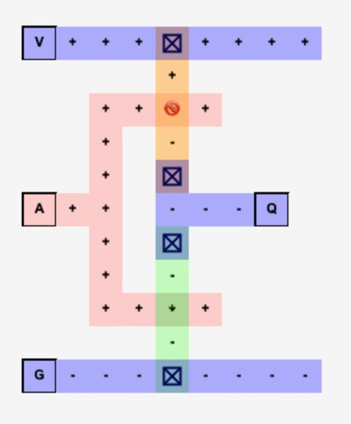
About My Emulators
My circuit layout and emulation tools are limited
Focused on learning objectives of the course
Run in the browser
They fail if circuits get too complex
There are many emulators that are more serious and more accurate – just search

Slide 12
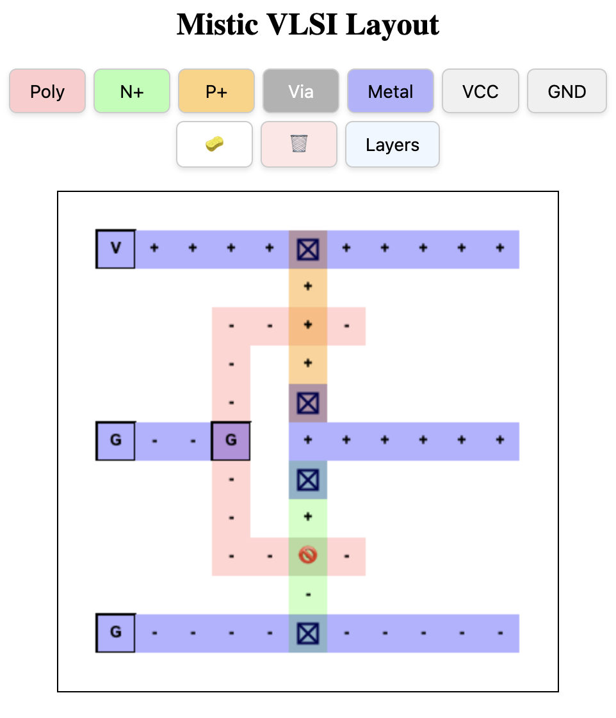

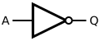
VLSI CMOS Not
Not
VDD
A
OUT
A | Q
0 | 1
1 | 0
GND

Slide 13
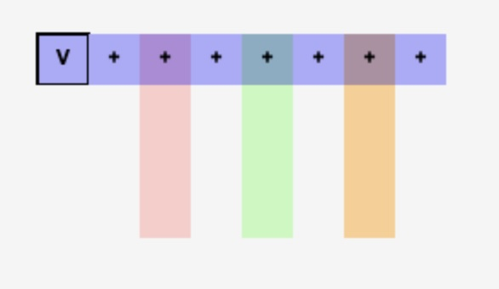
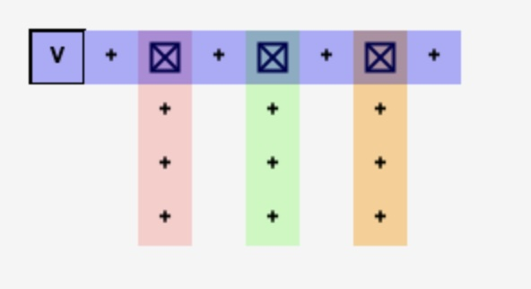
Drawing Layers
Metal – Conductor
N-Doped Silicon
P-Doped Silicon
Polysilicon
These are not connected unless you place a "Via" at a connection point
The Via is a vertical connector between layers

Slide 14
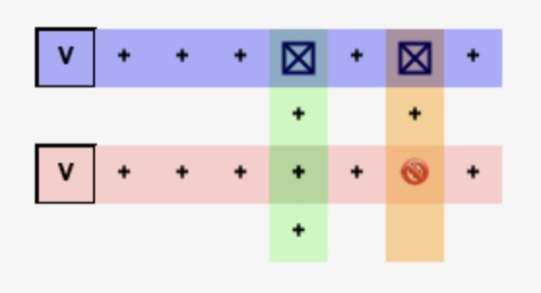
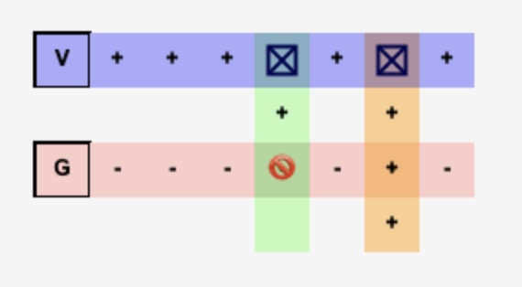
Transistors
When N-Doped Silicon crosses Polysilicon an NMOS Transistor is created
When P-Doped Silicon crosses Polysilicon an NMOS Transistor is created
The voltage on the Polysilicon controls the conductivity of the transistors

Slide 15
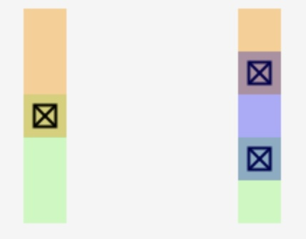
About Layout
Mistic is greatly simplified
Mistic circuit emulation is very simple
AI: Explain the differences between VLSI layout as might be used in the Magic circuit design tool and the actual construction of chips on silicon wafers
For example – You can't overlap N+ and P+ due to manufacturing limitations
Cannot be manufactured
Notes:
A picture with the left diagram showing P+ Silicon connecting directly to N+ Silicon with a Via which is not allowed. One the right the N+ and P+ are not touching be a short metal segment and two Vias are used to move current from the P+ to the N+.

Slide 16
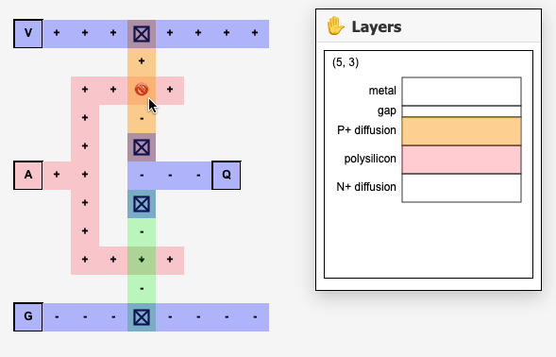
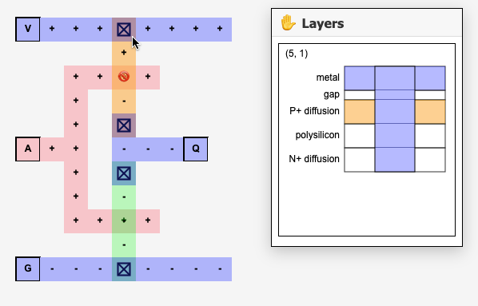
Looking at the Layers

Slide 17
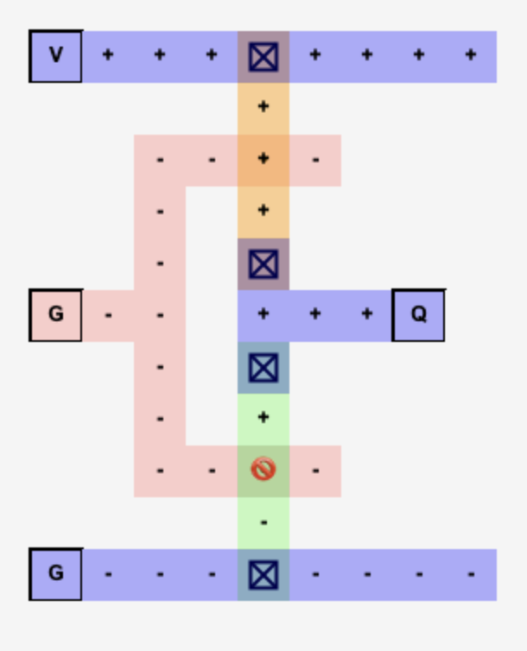
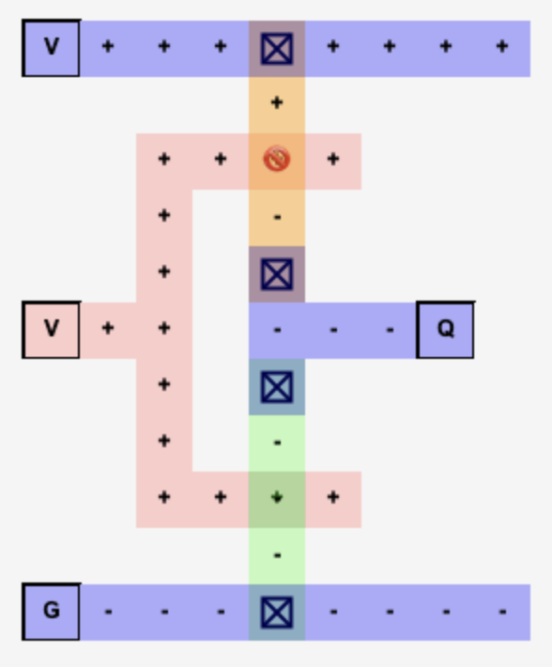
VLSI CMOS Not
VDD
Input 0
Input 1
A
OUT
GND

Slide 18
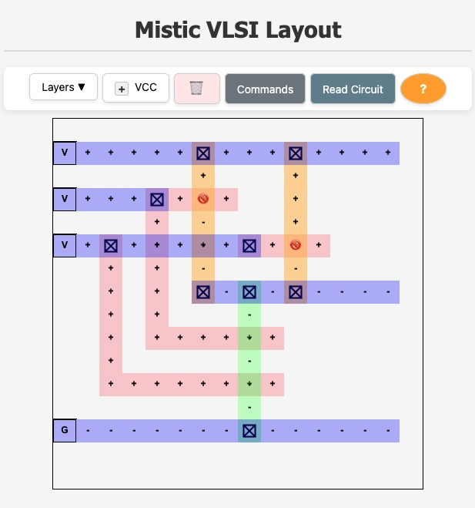
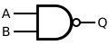
VLSI CMOS NAND
VDD
VDD
A | B | Q
0 | 0 | 1
0 | 1 | 1
1 | 0 | 1
1 | 1 | 0
A
B
OUT
A
B
GND

Slide 19
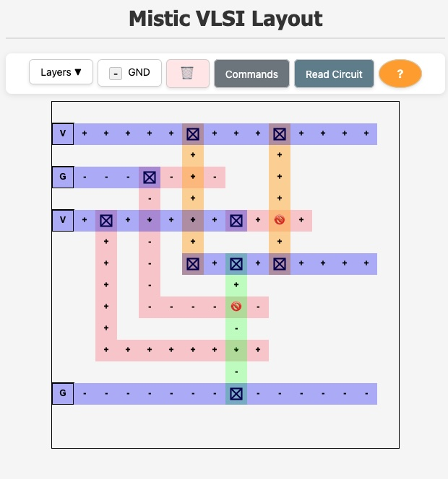
VLSI CMOS NAND
VDD
VDD
A | B | Q
0 | 0 | 1
0 | 1 | 1
1 | 0 | 1
1 | 1 | 0
A
B
OUT
A
B
GND

Slide 20
Summary
Number of transistors on a chip over time
Photo lithography
Designing VLSI chips

Slide 21
Acknowledgements / Contributions
These slides are Copyright 2025- Charles R. Severance (online.dr-chuck.com) as part of www.ca4e.com and made available under a Creative Commons Attribution 4.0 License. Please maintain this last slide in all copies of the document to comply with the attribution requirements of the license. If you make a change, feel free to add your name and organization to the list of contributors on this page as you republish the materials.
Initial Development: Charles Severance, University of Michigan School of Information
Insert new Contributors and Translators here including names and dates
Continue new Contributors and Translators here

